Slide 1
Producer consumer dataflow pattern

Slide 2
Producer Consumer Problem
Today we’ll build an async-compatible producer/consumer queue.
A producer/consumer queue is a classic problem in multithreading:
  you have one (or more) “producers” which are producing data
  you have one (or more) “consumers” which are consuming data,
  and you need some kind of data structure that will receive data from the producer(s) and provide it to the consumer(s).

Slide 3
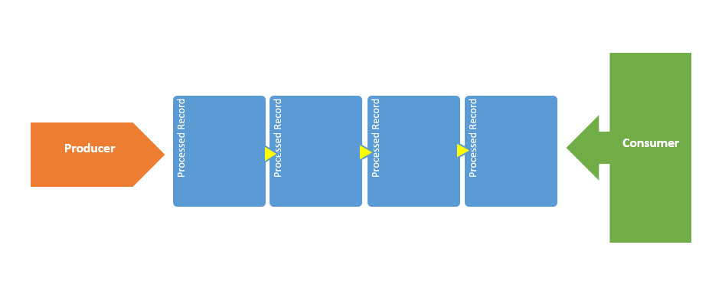
Producer Consumer Problem

Slide 4
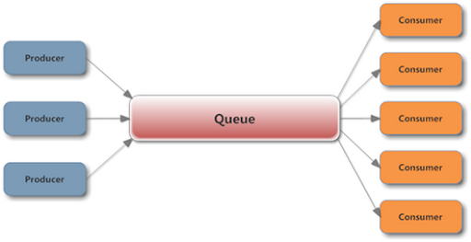
Producer Consumer Problem

Slide 5
Producers Consumers Systems
One system produce items that will be used by other system
Examples
  shared printer, the printer here acts the consumer, and the computers that produce the documents to be printed are the consumers.
  Sensors network, where the sensors here the producers, and the base stations (sink) are the consumer.

Slide 6
Producer Consumer Problem
As RTL Item_number++ is implemented as the following:
Register 1=Item_number;
Register1=register1 +1;
Item_number=register1;
and Item_number-- in the same way using different register.
Consider this execution interleaving with “count = 5” initially:
  S0: producer execute register1 = count {register1 = 5}
  S1: producer execute register1 = register1 + 1 {register1 = 6}
  S2: consumer execute register2 = count {register2 = 5}
  S3: consumer execute register2 = register2 - 1 {register2 = 4}
  S4: producer execute count = register1 {count = 6 }
  S5: consumer execute count = register2 {count = 4}

Slide 7
Producer
class ProducerThread(threading.Thread):
def __init__(self, group=None, target=None, name=None,
args=(), kwargs=None, verbose=None):
super(ProducerThread,self).__init__()
self.target = target
self.name = name
def run(self):
while True:
if not q.full():
item = random.randint(1,10)
q.put(item)
logging.debug('Putting ' + str(item)
+ ' : there are ' + str(q.qsize()) + ' items in queue')
time.sleep(random.random())
else:
logging.debug('Cant push --> Full Queue')
return

Slide 8
Consumer
class ConsumerThread(threading.Thread):
def __init__(self, group=None, target=None, name=None,
args=(), kwargs=None, verbose=None):
super(ConsumerThread,self).__init__()
self.target = target
self.name = name
return
def run(self):
while True:
if not q.empty():
item = q.get()
logging.debug('Getting ' + str(item)
+ ' : there are ' + str(q.qsize()) + ' items in queue')
time.sleep(random.random())
else:
logging.debug('Cant pop --> Empty Queue')
return

Slide 9
Main
if __name__ == '__main__':
p = ProducerThread(name='producer')
c = ConsumerThread(name='consumer’)
p.start()
time.sleep(2)
c.start()

Slide 10
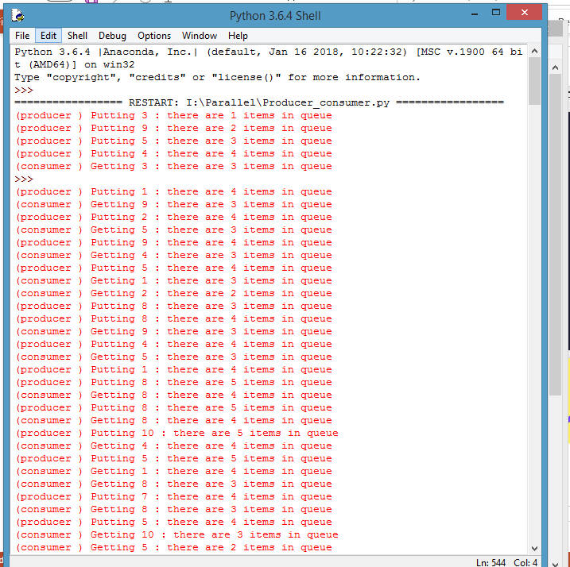


Slide 11
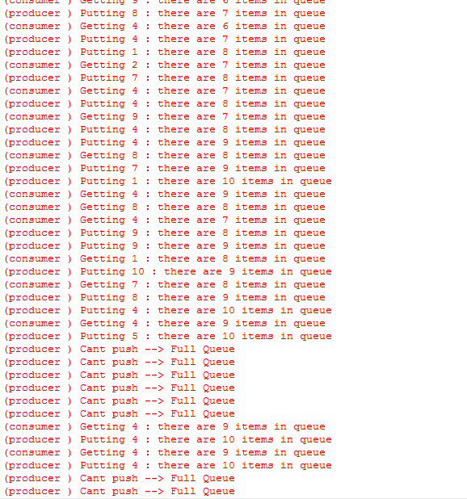

Slide 12
References
http://phoenix.goucher.edu/~kelliher/cs42/sep27.html
http://informatik.unibas.ch/lehre/ws06/cs201/_Downloads/cs201-osc-critsect-2up.pdf
http://sankofa.loc.edu/chu/web/Courses/Cosi410/Ch2/require.htm
http://www2.cs.uregina.ca/~hamilton/courses/330/notes/synchro/node2.html
http://www.cs.jhu.edu/~yairamir/cs418/os3/sld009.htm
http://doc.union.edu/152/Embedded

